Slide 1
Liquids

Slide 2
Welcome to this lesson on liquids! This Smart Lesson will teach you about liquids in a little more detail. By the end of this lesson, you should be able to:
Recall that liquids have a variable shape and a definite volume.
Explain that particles in a liquid have medium energy and are connected by some bonds.
Demonstrate your knowledge of particle behaviour and the physical properties of a liquid.

Slide 3
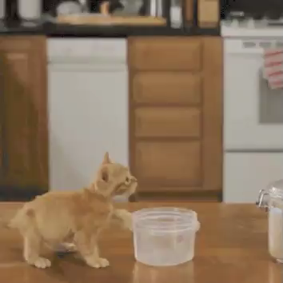
Liquids have a variable shape.
This means their shape will change to fit the container they are in.
For example, in the gif below, the milk is a different shape in the carton than in the container. This gif also shows how liquids can flow from one container to another by changing shape.

Slide 4
You are already familiar with the variable shape of liquids.
For example, liquids often make a bigger mess in the kitchen than solids, because they can change their shape.
If you drop a cup it will stay the same shape and you can just pick it up. This is because solids have a definite shape.
But if you spill your drink on the floor it will spread over the floor and make a puddle. It has changed its shape and made a mess.

Slide 5
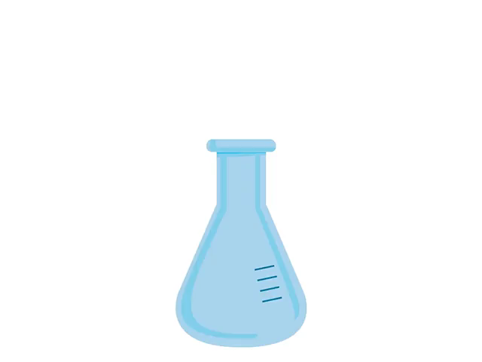
Like solids, liquids also have a definite volume.
This means they cannot change how much space they occupy.
When transferring a liquid from one container to another, it will change its shape to fit the new container but it will still take up the same total amount of space.

Slide 6
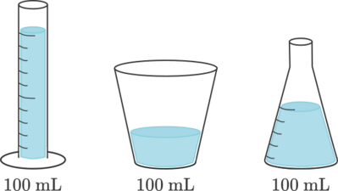
In the below picture, the same liquid is moved between three different containers.
In each container, the liquid takes on a different shape. However, each container has the same volume (100 mL) of liquid.

Slide 7
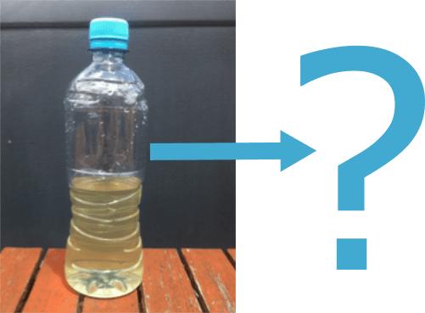
Another way to say that something cannot change its volume is to say it is incompressible.
This means that liquids cannot be compressed (squashed).
Knowing this, what would happen to the liquid in this bottle if you squeezed the bottle?

Slide 8
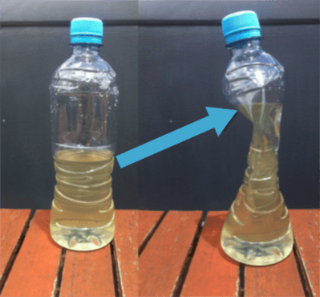
You cannot compress the liquid inside the bottle.
The liquid will change shape to fit the new shape of the container, but its volume will not change.
In other words, you will have the same amount of liquid as before, taking up the same amount of space, just shaped differently.

Slide 9
Solids that are made up of lots of tiny pieces may behave like liquids.
For example, you can pour sand from one container to another, and mould it into different shapes.
However, sand is not a liquid, it is made of lots and lots of individual grains that each have a definite shape. If you pour sand, you will notice how the sand piles up, but liquids spread out to fill their container.

Slide 10
The particles in a liquid behave in a particular way to give it a variable shape and definite volume.

Slide 11
The particles in a liquid have a medium amount of energy.
They have more energy than the particles of a solid, but less energy than the particles of a gas.
As a result, the particles have enough energy to overcome some of the attractions between them.
This means liquids have fewer bonds than a solid, but more bonds than a gas.

Slide 12
Liquids have a definite volume because the bonds hold the particles close together.
There is such a small amount of space between particles that it is negligible. So the particles of a liquid cannot be moved closer together.
Negligible: so small that it can be ignored.
Just like in a solid, this gives a liquid a definite volume.

Slide 13

Liquids have a variable shape.
Although liquids have enough bonds to hold their particles close together, they do not have enough bonds to hold the particles in a fixed arrangement.
Particles in a liquid can move around, sliding past one another. As a result, the arrangement of particles is random and always changing.

Slide 14
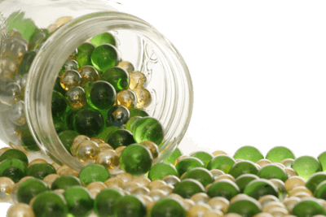
How can we visualise particle movement in a liquid?
Imagine you have a jar of marbles. These marbles represent particles in a liquid.
Tip the jar on its side. The marbles will rearrange by sliding over one another and spilling out of the jar.
Just like the marbles, particles in liquids can flow and change their arrangement.

